Slide 1
Study for POP Quiz!!! (10 min) Jamestown vs. Plymouth
Obj: I will be able to relay information that I learned concerning Jamestown and Plymouth
*When the timer goes OFF, notes UP & Quizzes OUT*
You will have 20 min. to take the Quiz!!!

Slide 2
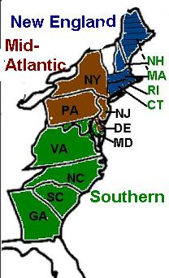
Colony Connections
Date!!
The three colonial regions are:
New England
Middle
Southern

Slide 3
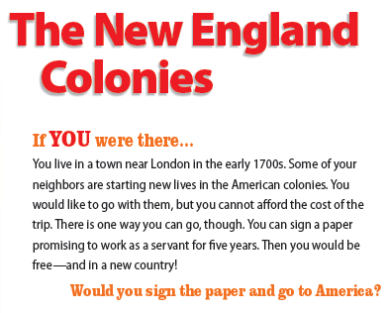

Slide 4
New England Colonies (New Hampshire, Rhode Island, Massachusetts, Connecticut)
Natural Resources: timber, fish and deep waters
Human Resources: Skilled craftsmen, shopkeepers and shipbuilders
Climate: mild summers and bitterly cold winters
Geography: Flat land close to coastline and hilly/mountainous farther inland

Slide 5
New England Colonies (New Hampshire, Rhode Island, Massachusetts, Connecticut)
Specializations: fishing, shipbuilding, & industry
Interdependence: depended on…
- Southern colonies for raw materials like cotton
- Middle Colonies for grain and livestock.

Slide 7
Middle Colonies (New York, New Jersey, Pennsylvania, Delaware)
Natural Resources: rich farmland and rivers
Human Resources: unskilled and skilled workers, fishermen
Climate: warm summers and cold winters
Geography: rolling hills and mountains further inland

Slide 8
Middle Colonies (New York, New Jersey, Pennsylvania, Delaware)
Specializations: livestock, grain and fish
“Breadbasket” colony because of large amts of barley, wheat, oats and rye
Interdependence: depended on…
- traded with both New England and Southern colonies to get the products they did not produce.

Slide 9
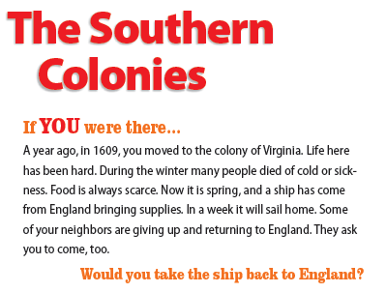

Slide 10
Southern Colonies (Maryland, Virginia, North Carolina, South Carolina, Georgia)
Natural Resources: fertile land, rivers and harbors
Human Resources: farmers and enslaved African-Americans
Climate: hot summers and mild winters
Geography: flat with rolling hills inland

Slide 11
Southern Colonies (Maryland, Virginia, North Carolina, South Carolina, Georgia)
Specializations: tobacco, cotton, indigo, wood products
Interdependence: depended on…
- New England colonies for manufactured goods, including tools and equipment.

Slide 13
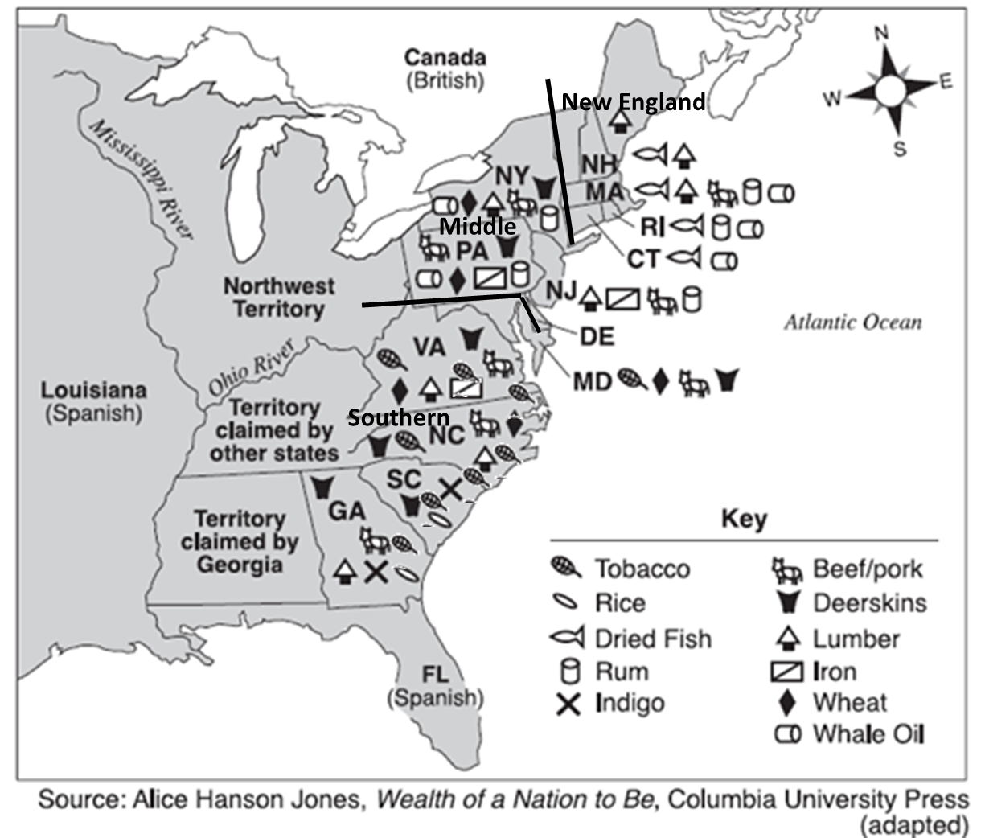

Slide 14
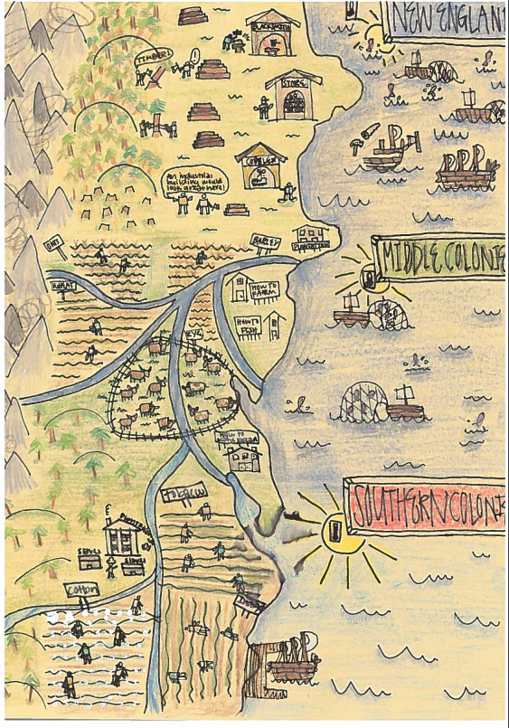
I will create a Visual Representation of the 13 Colonies and the characteristics, geography, resources and specializations:
(Use slides 13 (80) & 14 (100) as examples)
Requirements:
No Stick Figures, the more time you spend illustrating the more likely you are to remember
The more details the better the grade
Color me w/Map (colored) Pencils
Specify your Colonies (New England Colonies, Middle Colonies, Southern Colonies
Extras:
If you think I won’t understand your symbol, create a Key

